Slide 1
Stock Market Prediction
Members:
Gerardo Wibmer, Jun Kim,
Paul-Ann Francis, Tahsun Khan

Slide 2
Proposal & Goals:
Stock Index Price Prediction
Stock prices are by nature volatile and non-linear which makes them difficult to predict even with various advanced analysis techniques or computer algorithms. Team C will use a recurrent neural network (RNN) to predict the daily closing price of the S&P 500 Index between the time periods of January 1, 2015 to January 1, 2020.
Research Question: Can an RNN predict a stock’s daily closing price with at least 90% accuracy using a technical analysis based approach supported by historical stock data?
Importance: Accurately predicting stock prices using machine learning algorithms such as neural networks has a few promising benefits but the most significant is the profits an investor can earn. This experiment is key in discovering the future value of publicly traded assets.

Slide 3
Literature Review 1

Slide 4
Stock Closing Price Prediction using Machine Learning Techniques
Written by Mehar Vijha , Deeksha Chandolab, Vinay Anand Tikkiwalb, Arun Kuma.
In this work, two techniques i.e. ANN and Random Forests have been used for predicting the closing price of an organization but as a Team we mainly focused on the ANN results.
The models use a set of new variables created through the manipulation of variables provided in the Yahoo financial dataset; the latter being: Open, High, Low, Adjacent Closing, Volume and, Close of four particular companies.
How well the model performed was tested using three measures: Root Mean Squared Error(RMSE), Mean Absolute Percentage Error (MAPE) and Mean Bias Error (MBE).

Slide 5
Model & Method
The dataset spanned April 5, 2009 to April 5, 2019 and encompassed information for Nike, Goldman Sachs, Johnson and Johnson, Pfizer and JP Morgan Chase and Company.
The model works with three layers. First was the input layer, then the hidden layer and then finally the output layer. The input layer consists of new variables which are H-L, O-C, and 7 DAYS MA, 14 DAYS MA, 21 DAYS MA, 7 DAYS STD DEV and Volume

Slide 6
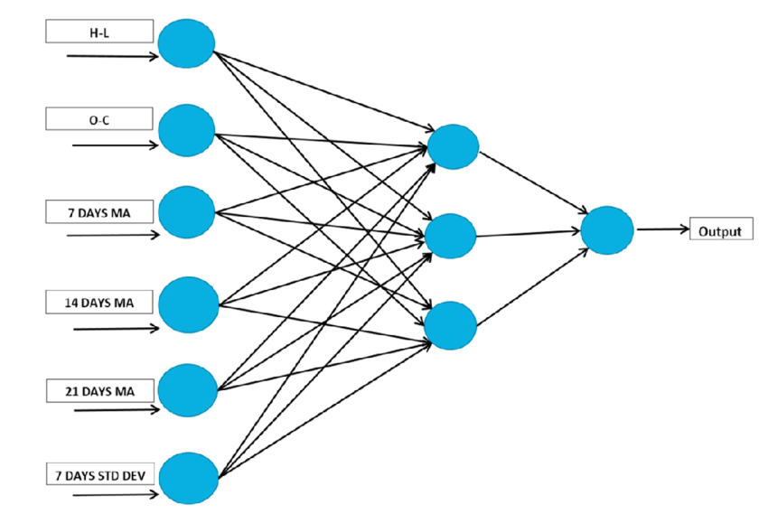
Model & Method
Fig. 1. Detailed architecture
of Artificial Neural Network
(ANN) for stock price
prediction.

Slide 7
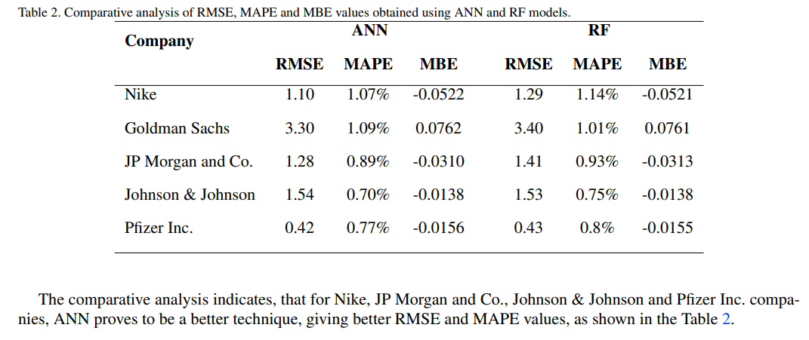
Results of the ANN

Slide 8
Literature Review 2

Slide 9
Research on Stock Price Prediction Method Based on Convolutional Neural Network
Written by Sayavong Lounnapha , Wu Zhongdong , Chalita Sookasame
This paper proposes a stock price prediction model based on convolution neural network, which has obvious self-adaptability and self-learning ability. The models used:
Convolutional Layer
Pooling Layer
Fully Connected Layer
Dropout

Slide 10
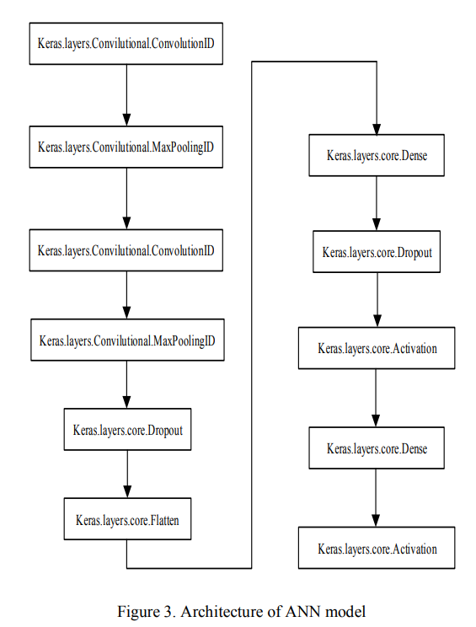
Research on Stock Price Prediction Method Based on Convolutional Neural Network
Experimental Design:
Data Preparation and Preprocessing
Experiment on Convolutional neural network architecture
Results and Analysis

Slide 11
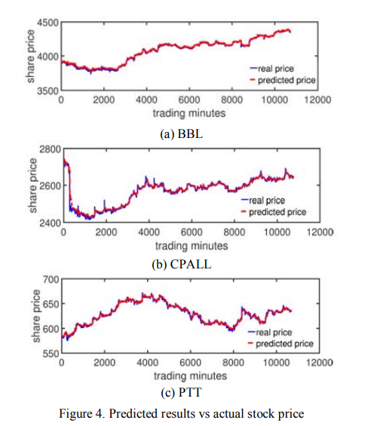
Research on Stock Price Prediction Method Based on Convolutional Neural Network
The results were effective in identifying the trends
Prediction Accuracy - high
This encourages further promotion in the financial field.

Slide 12
Literature Review 3

Slide 13
Stock Market Prediction
Using Machine Learning
Written by Ishita Parmar, Navanshu Agarwal, Sheirsh Saxena
The main objective of this paper is to develop a reliable forecasting model for stocks that utilizes the powerful capabilities of a Long Short-Term Memory (LSTM) neural network.
Data Set:
Historical price data from Yahoo Finance.
The dataset consisted of 900,000 records.
Parameters : date, symbol, open, close, low, high and volume.

Slide 14
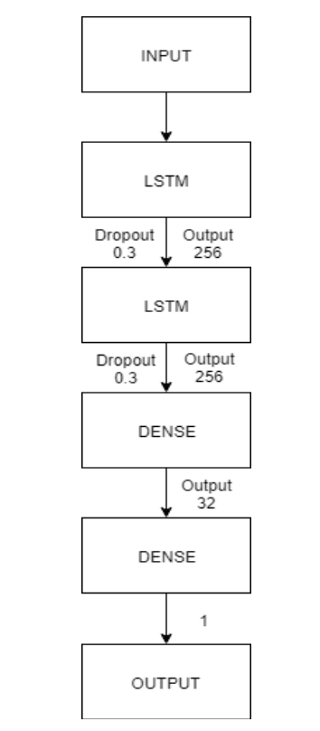
Long short-term memory (LSTM)
The paper uses a sequential model consisting of two stacked LSTM layers with 256 output values.
A dropout value of 0.3 was fixed to freeze 30% of total nodes during training.
LSTM's memory cell selectively remembers relevant historical data, giving it an edge over dense layers in capturing the temporal dependencies of stock market data.

Slide 15
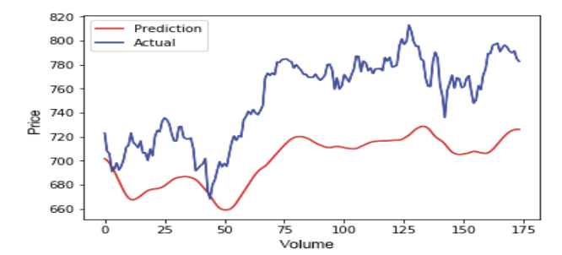
Experimental Results
Actual & Predicted Trend of LSTM
The model resulted in a Train Score of 0.00106 MSE (0.03 RMSE) and a Test Score of 0.00875 MSE (0.09 RMSE).
The more the system is trained and the greater the size of the dataset utilized the greater the accuracy which will be attained
Notes:
The more the system is trained and the greater the size of the dataset utilized the greater the accuracy which will be attained. The LSTM Model offered more accuracy than the Regression based Model.
LSTM models are generally more effective than regression models in predicting stock market movements because they can capture complex relationships and dependencies in the data.

Slide 16
Literature Review 4

Slide 17
Effectiveness of AI in Stock Market
Prediction Based on ML
Attempts to use a fundamental analysis, rather than technical analysis (regression ML algorithms)
Fundamental Analysis
Integrating other social factors such as politics and public sentiment into technical analysis
Goal
Incorporate public Tweets associated with the stock markets to provide an even more accurate prediction

Slide 18
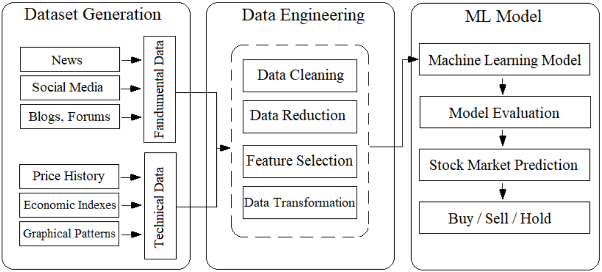
Effectiveness of AI in Stock Market
Prediction Based on ML
Dataset
Historical price data from Yahoo Finance
Sentiment analysis data on Twitter
Model
ANN, DT, SVM, LR, GNB, BNB, RF, KNN, XGB, Linear Regression, LSTM

Slide 19
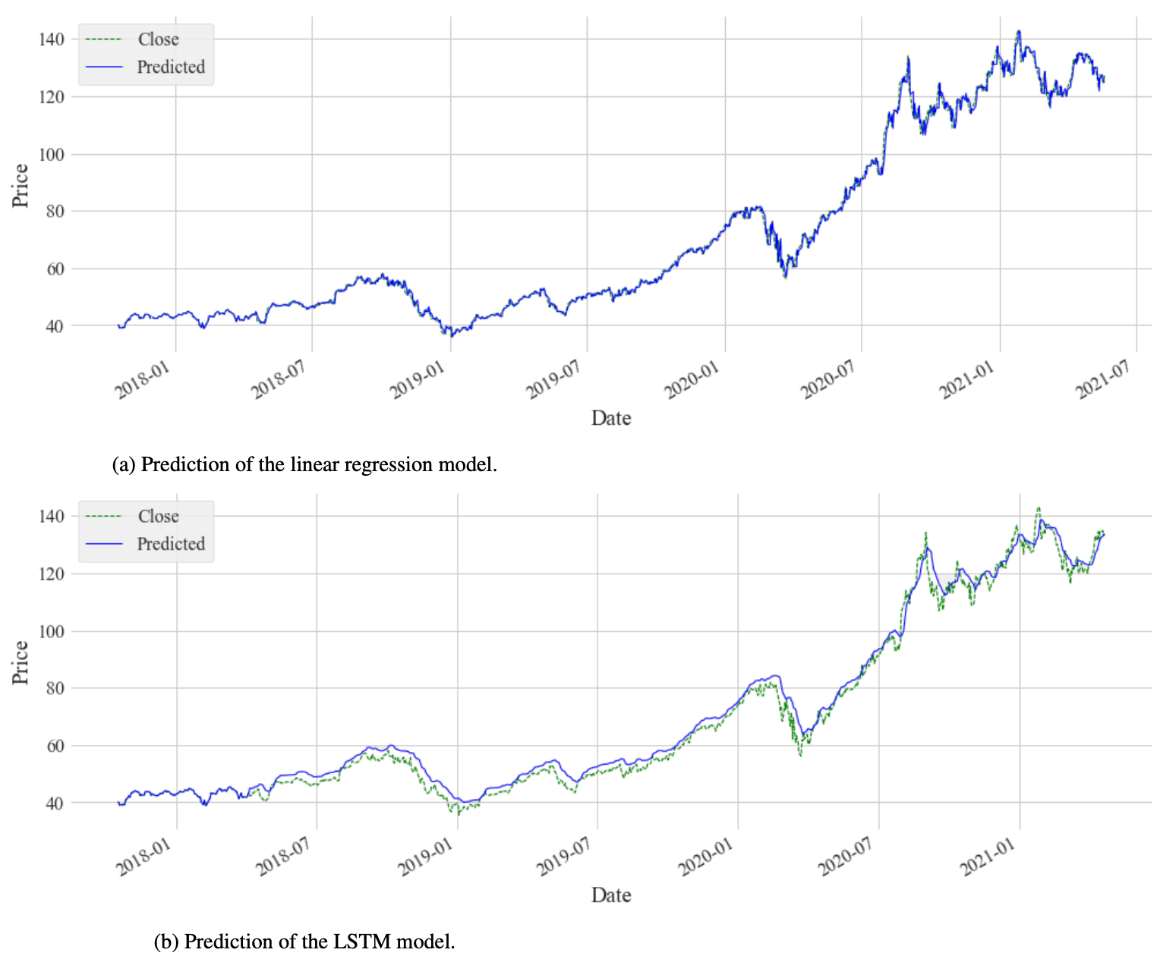
Effectiveness of AI in Stock Market
Prediction Based on ML
Result
Does not show promising results

Slide 20
Our Plans & Goals

Slide 21
Dataset Statistics
Stock Index: Standard & Poor’s 500 (Ticker: ^GSPC)
Dataset Source: Yahoo Finance
Time Period: January 1, 1960 to January 1, 2020
Number of Columns: 6 (Y Labels) - Volume, Opening Price, Adjacent Closing Values, High and Low of each day
Total Number of Features: 15, 372 (X Data)
Training Set: 10,080 for training set and 3,780 for validation set
Testing Set: 1,260

Slide 22
Our Plan
Goal
Use an RNN to predict the daily closing price of the S&P 500 Index using:
Training Dataset: January 1, 1960 to December 31, 1999
Validation Dataset: January 1, 2000 to December 31, 2014
Testing Dataset: January 1, 2015 to January 1, 2020

Slide 23
Our Plan
Dataset
Features: Volume, Opening Price, Adjacent Closing Values, High and Low of each day
Prediction: Closing Price
The testing data stops in 2020 due to the irregularity of the market caused by the pandemic. The dataset consists of historical data on the index sourced from Yahoo Finance.

Slide 24
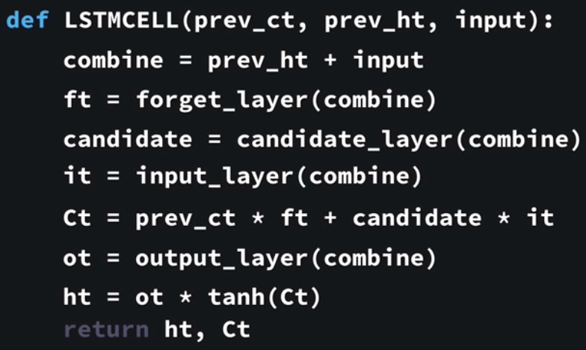
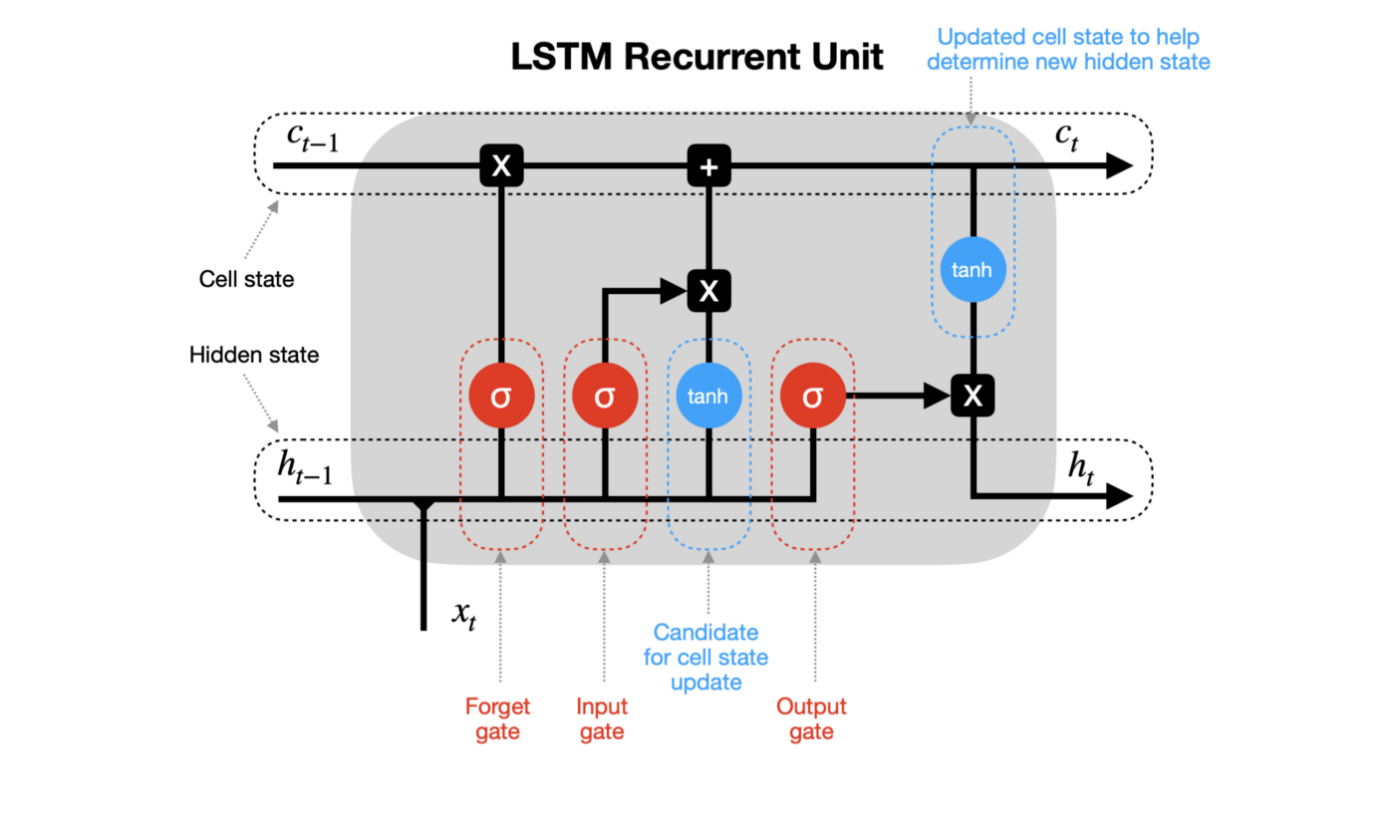
Our Plan
Model
Multiple LSTM layers connected with Dense layers (as seen in paper 3)
Possibly dropout regularization (as seen in paper 2, 3)

Slide 25
Questions

Slide 26
References
The Links to the Research Papers
https://www.sciencedirect.com/science/article/pii/S1877050920307924
https://ieeexplore.ieee.org/abstract/document/8920761?casa_token=ortIStTUK08AAAAA:Px-O5Js_VRcM1q6MgrIRSiSD5T5PxBeVq8GG-puKz3aN7frIDifuUxop21POCRXwYcx3RTJ4tg
https://ieeexplore.ieee.org/stamp/stamp.jsp?tp=&arnumber=8703332
https://arxiv.org/abs/2107.01031

